Slide 1
Interictal spikes during sleep are an early defect in a mouse model of β-amyloid neuropathology
Korey Kam
Helen Scharfman Lab

Slide 2
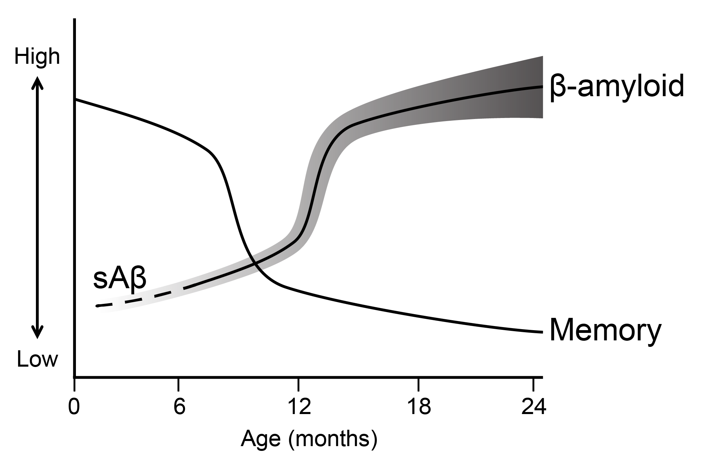
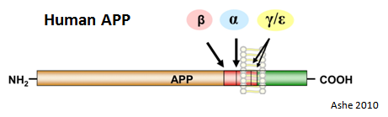
What happens early?
?
Hsiao et al. 1996
Westerman et al. 2002
Jacobsen et al. 2006
Wesson et al. 2010
Duffy et al. 2015
and others
Notes:
We are interested in what happens here. What happens prior to amyloid deposition and memory impairment?

Slide 3
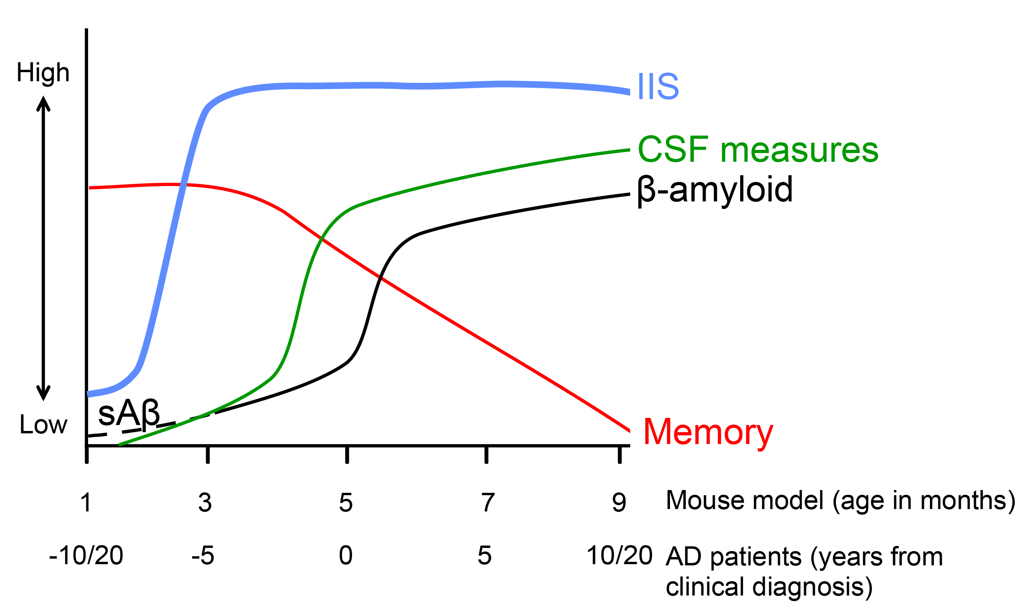
Are hAPP mice relevant tools?
Notes:
Abnormalities in brains of AD patients are thought to begin long before the first clinical symptoms emerge such as presentation with memory impairment. Human APP mice model some of the hallmarks of AD, such as accumulation of soluble Abeta along with behavioral deficits that worsen with age. But what is the evidence that hAPP mice are relevant translational tools? After I’m done showing the data, I hope to convince that we have some evidence that IIS are an early abnormality.

Slide 4
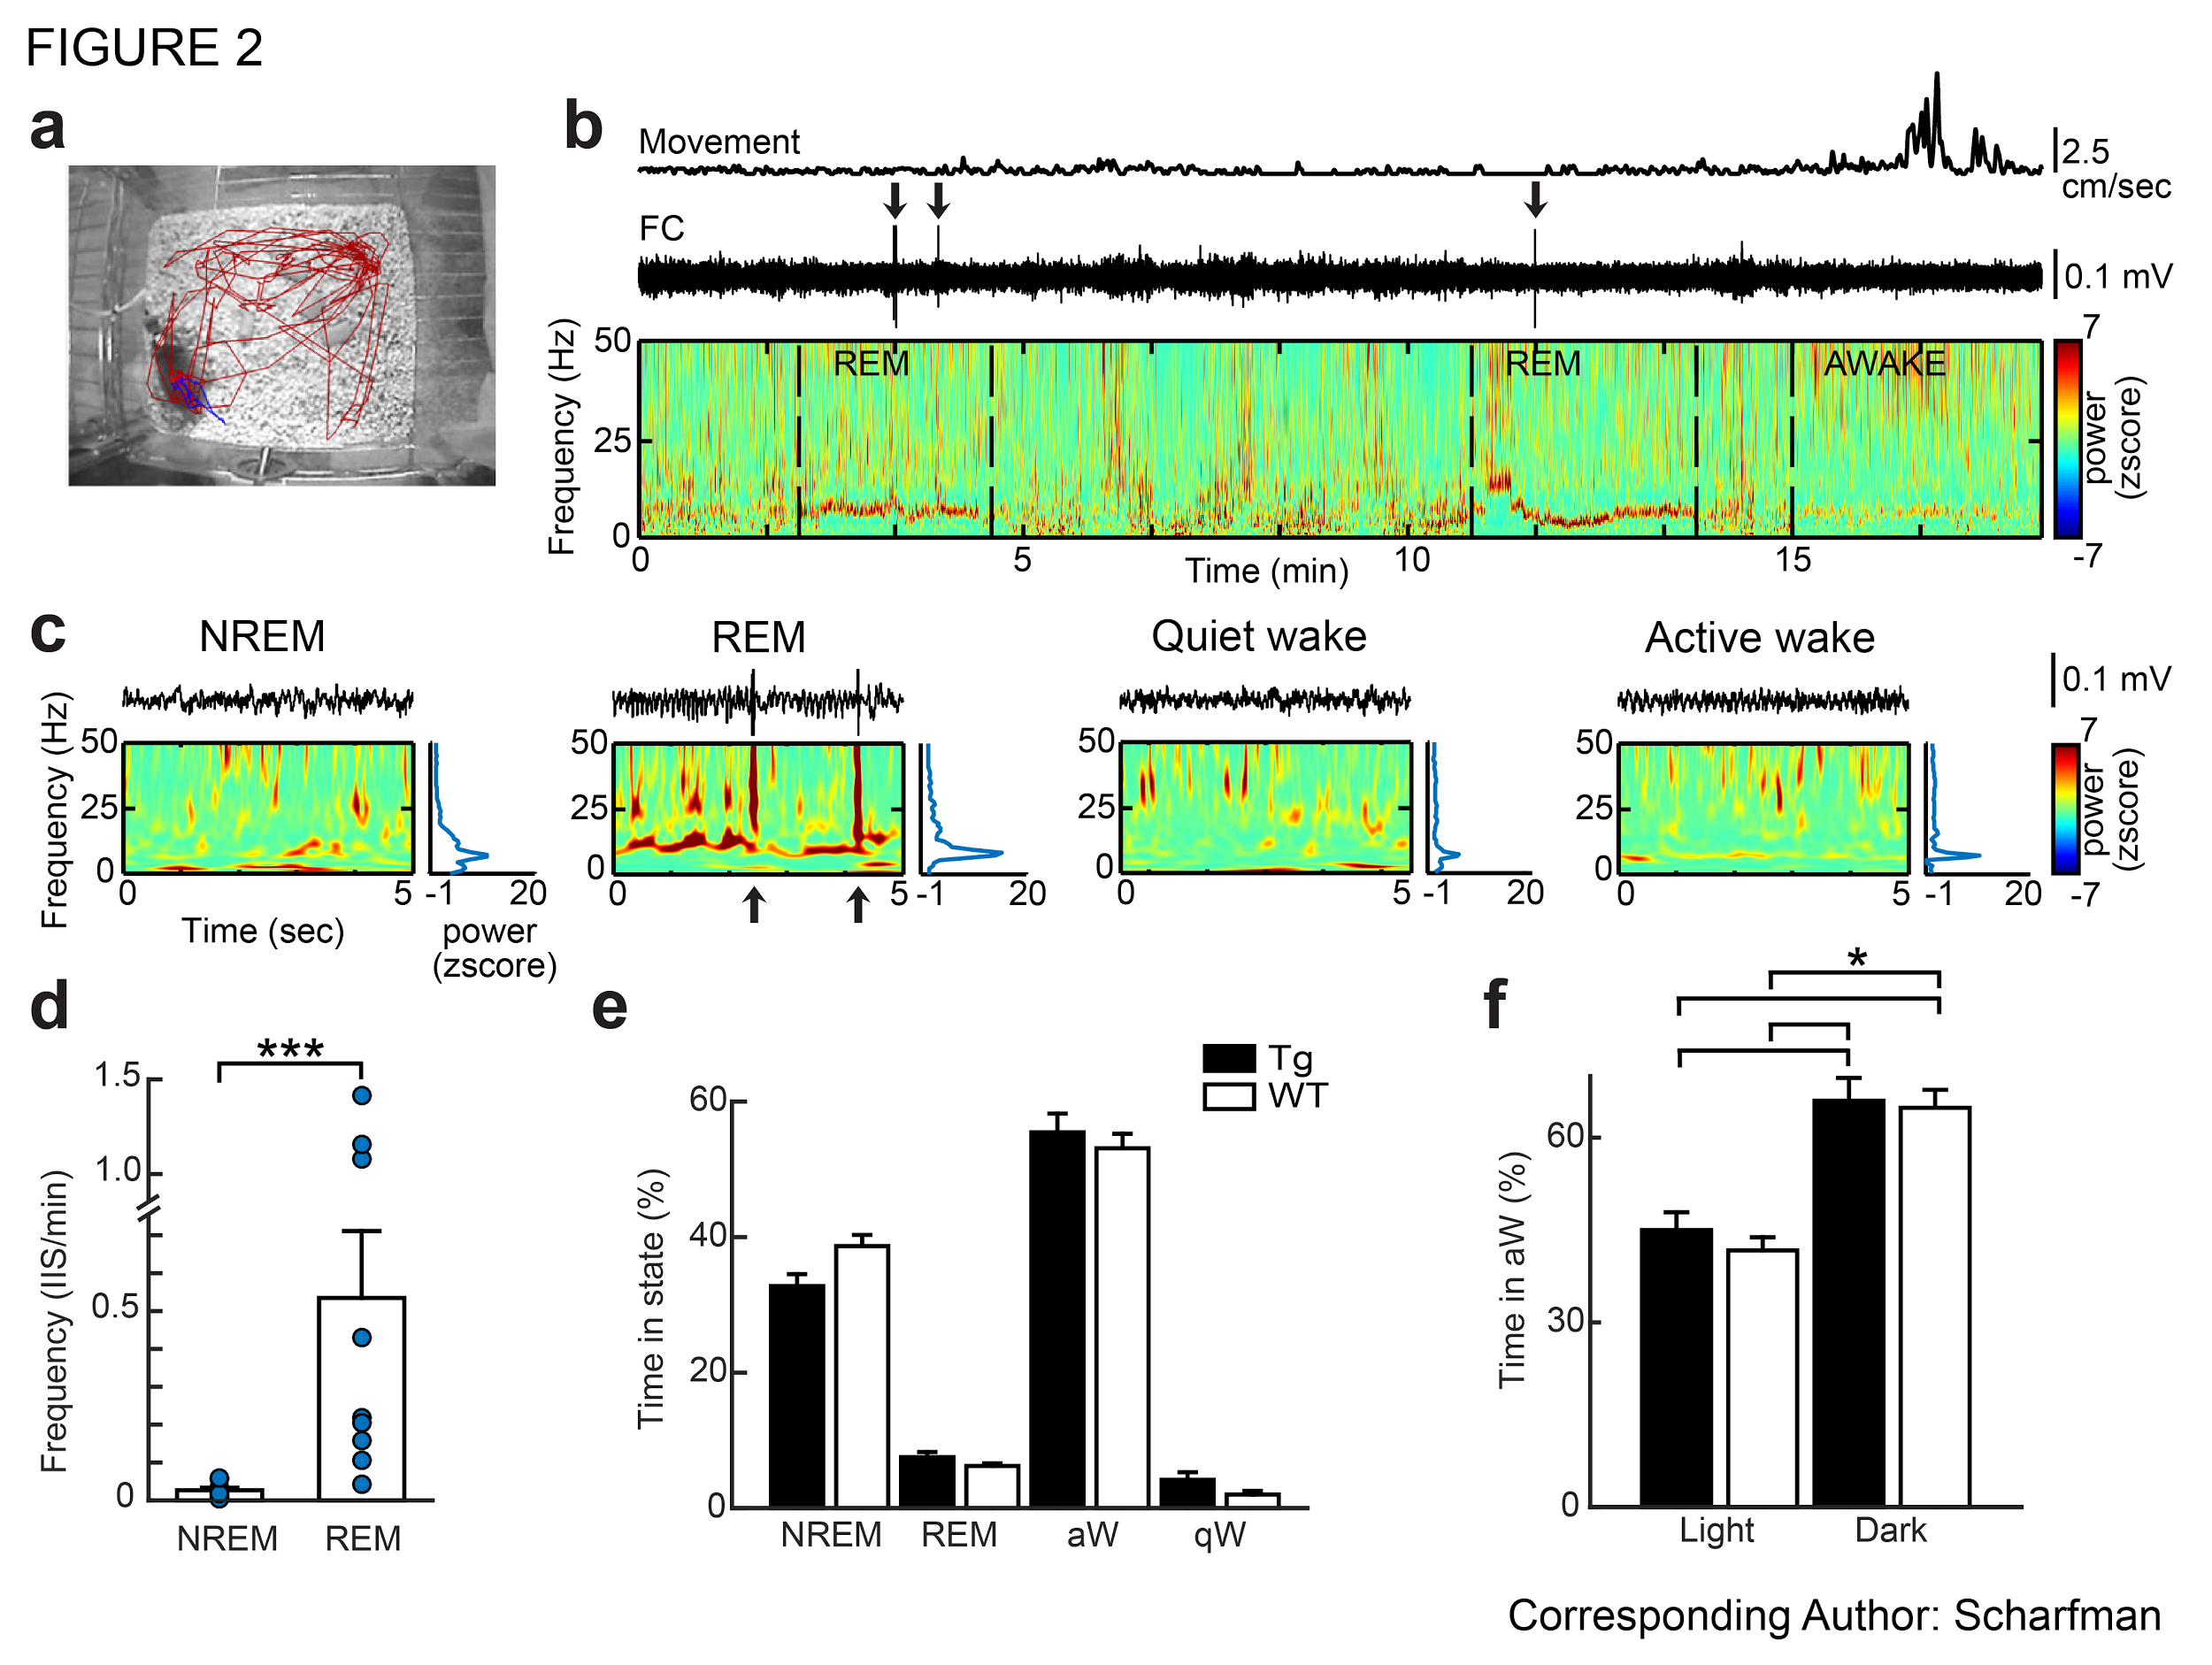
IIS are in REM sleep
Notes:
We observed IIS predominantly in REM sleep at 5wks old. To quantify this observation, we defined behavioral state for the entire 24hr long recording. Behavioral state was classified using two types of information: the tracking of animal position along with spectral measures of the EEG.
Shown here is a 20 minute long clip with the detected movement, EEG with the computed spectrogram. Hot colors indicate greater power and cooler green indicates low power.
5 second long clips illustrate each behavioral state. Periods without movement were defined as NREM, REM sleep or quiet wakefulness. Notice that IIS occur in periods of predominant theta (5-10 Hz) within REM sleep.

Slide 5
Oscillations in brain signals
Notes:
Brain signals appear noisy, but contain rhythmic, oscillatory events.

Slide 6
Oscillations in brain signals
Main
=
Cycles/sec?
10
+
Cycles/sec?
5
+
Cycles/sec?
Noise (normal dist)
Notes:
Brain signals appear noisy, but contain rhythmic, oscillatory events embedded within. Count the number of peaks per signal.

Slide 7
Basics of a signal
Period
Notes:
A signal can be described by three characteristics over time:
Amplitude
Phase
Period (peak to peak or trough to trough)

Slide 8
Spectral analysis—principle
Notes:
In order to find these rhythmic events, we use spectral analysis to decompose or separate the heterogeneous signal into homogenous components. Think of it as a mixture of components that we are trying to “unmix”

Slide 9
Spectral analysis—power
Notes:
A measure of oscillatory magnitude, is the power in a frequency band.

Slide 10
Spectral analysis—time-frequency
Notes:
Spectral analysis can also be performed on time varying data, known as time-frequency analysis.

Slide 11
Spectral analysis—time-varying metrics

Slide 12
Demo
kk_demo_FT_specAnalysis
Notes:
149 signals, oh my!

Slide 13
extra! extra! read all about it!
Notes:
If time permits…

Slide 14
Spectral analysis—coherence
Notes:
A measure of oscillatory magnitude, is the power in a frequency band.

Slide 15
Multivariate analysis—synchrony
Notes:
A measure of oscillatory magnitude, is the power in a frequency band.

Slide 16
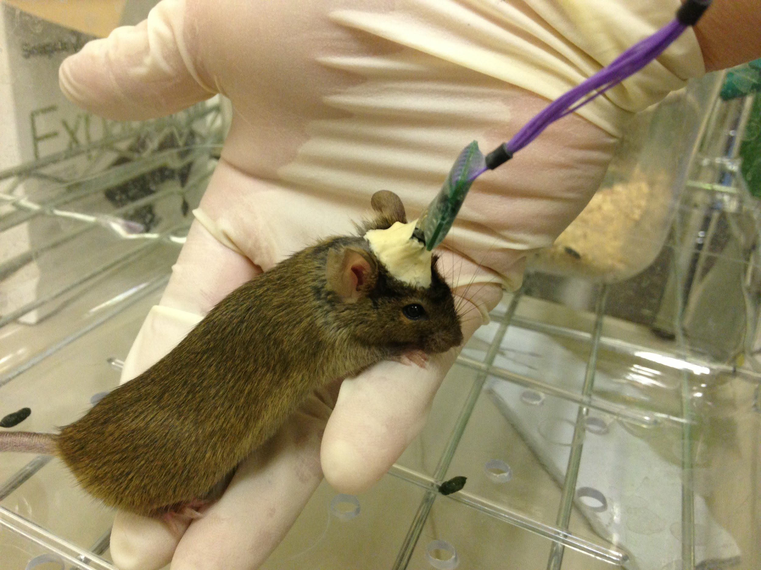
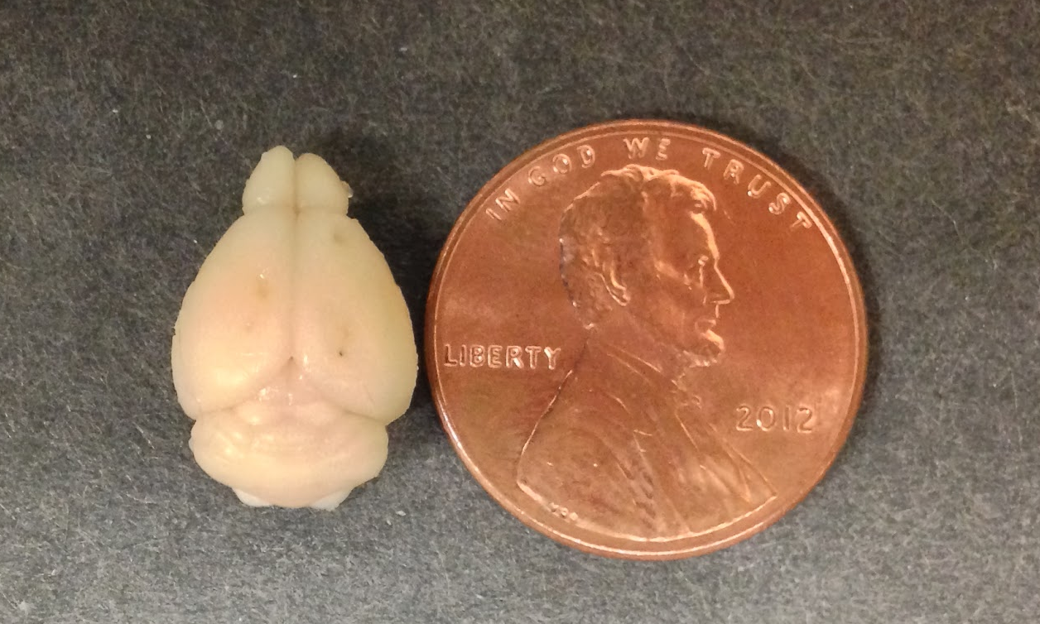
Approach
Video-EEG
Notes:
To address this question, we record in freely behaving Tg2576 mice for 24 hours continuously in the home cage, at ages far before the deposition of plaque or impairment of memory. Our recording electrodes target bilateral dorsal hippocampi as well as frontal and occipital cortices.

